Slide 1
Sustainability at Walmart
February, 2013
The Pesticide Stewardship Alliance

Slide 2
Sustainability at Walmart
Overview
Notes:
1

Slide 3
Helping customers save money and live better around the globe Over ten thousand retail units in 27 countries
Canada
United Kingdom
China
U.S.
Japan
Mexico
Central America
India**
Brazil
Sub-Saharan Africa
Chile
Argentina

Slide 4
Our three aspirational goals
Helping to organize and guide all of the work we do
To be supplied 100% by renewable energy
To create zero waste
To sell products that sustain people and the environment
Notes:
3
3

Slide 5
Sustainability contributes to business results
Operate for Less
Buy for
Less
Saving people money so they can live better.
Grow
Sales
Sell for Less

Slide 6
Our results are delivered through working together
Notes:
5
5

Slide 7
What we are working on now
2013
Notes:
6

Slide 8
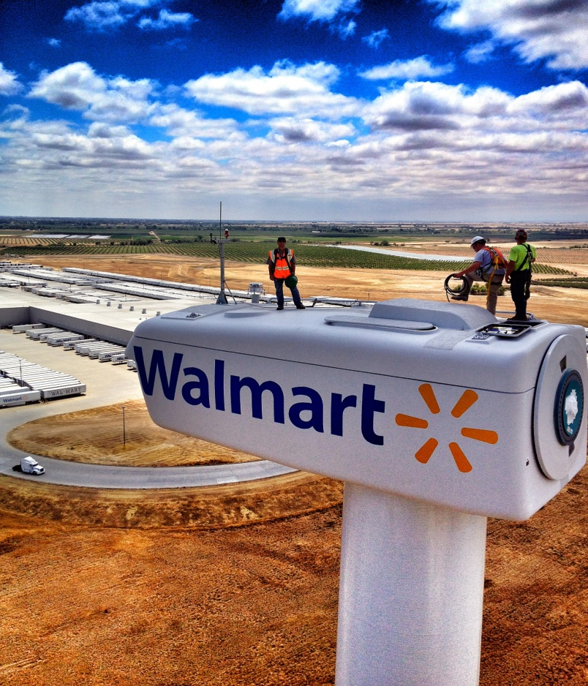
Current commitments
Aggressively delivering results in our own operations
Sustainability is driving value and every day low cost all across Walmart
Reducing waste within our own operations
Making our buildings and fleet more efficient
Expanding our renewable energy footprint

Slide 9
Current commitments
More sustainable products
Sell products that sustain people and the environment
Work across the industry to develop scientifically based information on products
Develop the tools and processes that enable merchants, suppliers, and others to drive improvements
Accelerate the Sustainability Index through targeted work in specific categories

Slide 10
Current commitments
Reducing greenhouse gas emissions
Walmart will eliminate 20 million metric tons of GHG emissions from our global supply chain by the end of 2015
Work across industries to drive large scale systematic change
Leverage the Sustainability Index to drive product and supply chain innovation
Provide the tools and processes to capture the “long tail” of smaller scale improvements

Slide 11
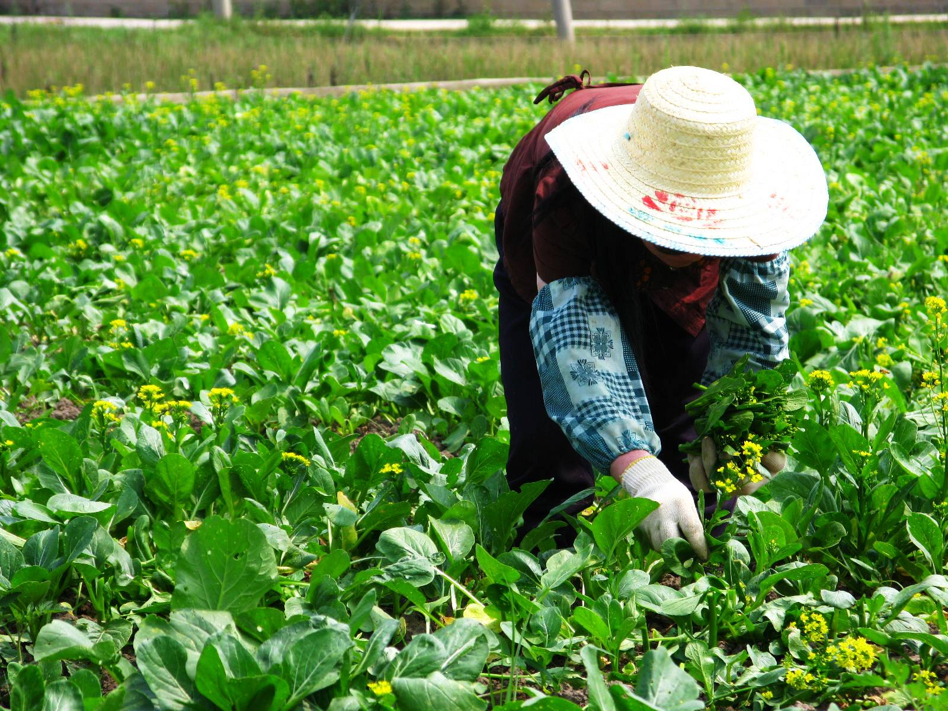
Current commitments
Sustainable agriculture
We will accelerate our efforts to grow our food business in a more sustainable way
To help small and medium sized farmers lead a better life
To reduce the impact of agriculture on the land and sensitive ecosystems
To bring our customers more affordable and higher quality food

Slide 12
To learn more
Notes:
11

Slide 13
Resources
Sustainability Website:
www.walmartstores.com/sustainability
Sustainability DVD:
http://walmartstores.com/Video/?c=577
Notes:
12

Slide 14
Thank you!
Notes:
13

